Slide 1
CAPSTONE PROJECT
Play Store App Review Analysis
Presented By:
1. Viharika.B-Alagappa College of Technology(Anna University)-Pharmaceutical Technology

Slide 2
OUTLINE
Problem Statement
Proposed System/Solution
System Development Approach
Algorithm & Deployment
Result
Conclusion
Future Scope
References

Slide 3
PROBLEM STATEMENT
The Play Store apps data has enormous potential to drive app-making businesses to success. Actionable insights can be drawn for developers to work on and capture the Android market. Play Store is one of the largest and most popular android app stores with over a million apps and the app reviews have a significant impact on the success of an app, influencing download rates, user engagement, and long-term retention.
Our main objective is to analyze the dataset and find out which features contribute to app success and how app review features affect the user engagement with the app.

Slide 4
PROPOSED SOLUTION
App version has significant impact on app success. This may be due to feature updates which provide improvements in user interface(UI), bug fixes, and performance enhancements. These updates can attract existing users to continue using the app and encourage new users to download it. Overall it enhances user experience and user engagement.
High rating with high thumbs-up count contribute to app success. They contribute to overall success of app by increasing visibility, user trust, downloads, engagement, retention, and monetization opportunities.
The legitimacy of the rating of a review can be inferred from the thumbs-up count, hence it can be considered as a pathway for review data analysis.
By leveraging insights from user reviews, developers can iteratively improve their app, address user concerns, and create a more enjoyable and valuable experience for their users, ultimately driving app success and user satisfaction.

Slide 5
SYSTEM APPROACH
Building the proposed solution would involve a combination of data processing, feature engineering, and machine learning. Here are the key system and library requirements:
System requirements:
1. Hardware:
A computer with sufficient processing power, preferably with multiple cores or a CPU for faster training of machine learning models. Adequate RAM to handle the size of the dataset and computational requirements.
2. Software:
An operating system compatible with the required machine learning platform.
Library requirements:
Data processing and analysis:
Pandas(for data manipulation and analysis), NumPy(for numerical operations on data)
2. Data visualization:
Matplotlib, Seaborn(for creating visualizations to understand data patterns)

Slide 6
ALGORITHM & DEPLOYMENT
Data exploration:
Explore the Google play store app review dataset’s structure, feature and target variables.
Identify potential patterns, correlations and outlines.
Problem Formulation:
Define the problem: To predict correlation between app engagement and success using app review dataset.
Algorithm Selection:
Regression task :
Consider the bar graph and correlation table.
Classification task:
Consider scatterplot and distribution plot.
Data Collection
Gather historical app review dataset including information on rating, size, category and other relevant app review details.

Slide 7
ALGORITHM & DEPLOYMENT
Data Cleaning:
Handle missing values and any inconsistencies in the dataset.
Convert categorical variables into numerical representations through encoding techniques.
Feature engineering:
Create new features or modify existing ones based on domain knowledge.
Extract meaningful information from review and version variables such as app version, review version, thumbs up count and score.
Model training:
Use the selected algorithm to train the model on the training dataset.
Model evaluation:
Evaluate the model on testing dataset using appropriate matrices.
Fine tune the model if necessary.
Result interpretation:
Interpret the models prediction in the context of the problem at hand.

Slide 8
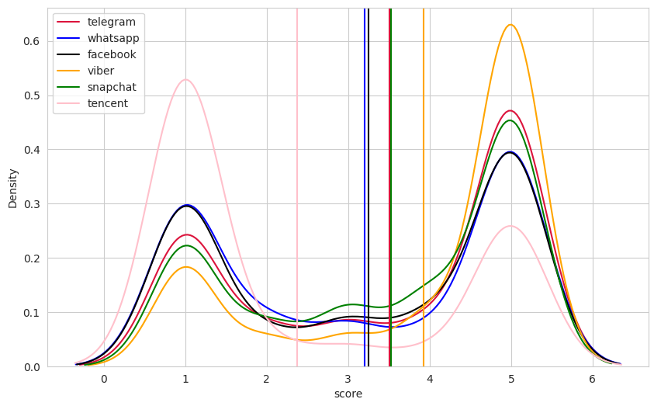
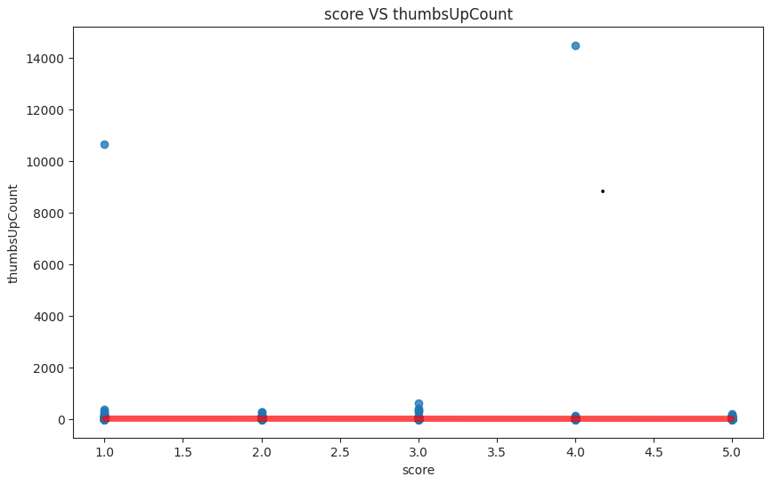
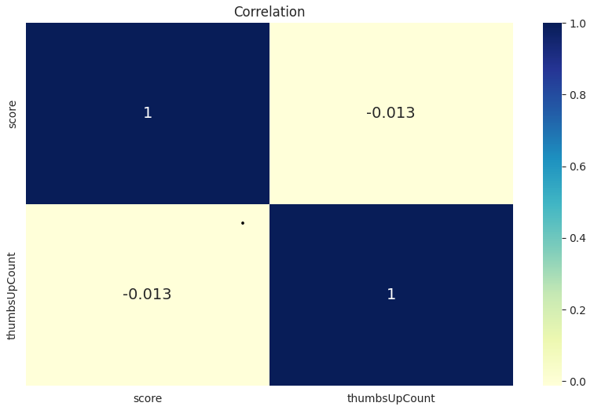
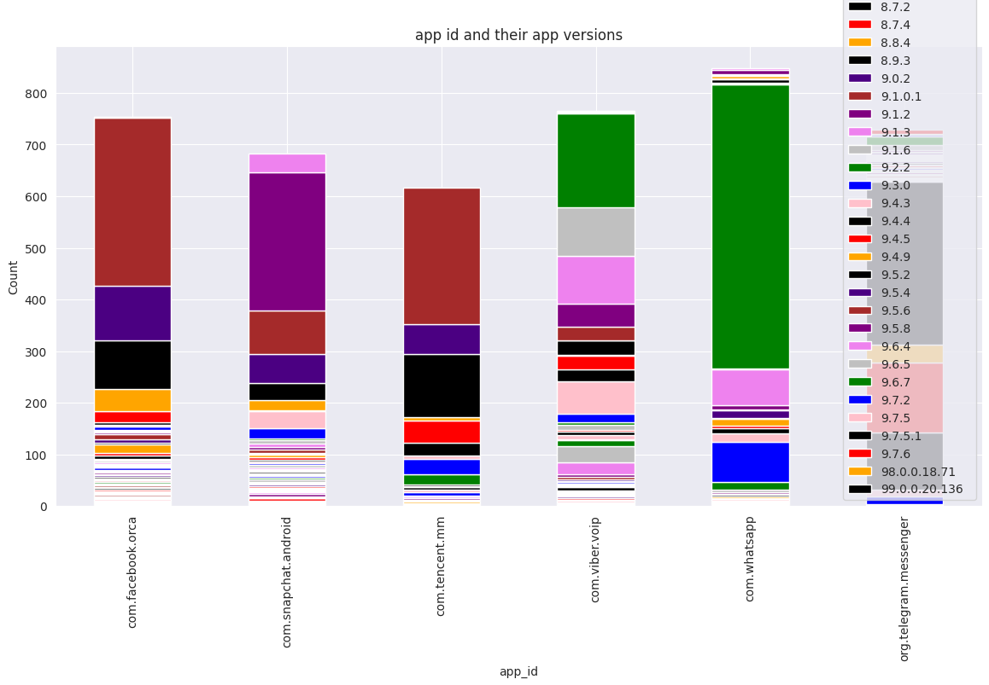
RESULT

Slide 9
CONCLUSION
In conclusion, our proposed solution harnesses the power of advance machine learning algorithms to transform the app review process into a dynamic and optimized experience by meticulously analyzing extensive historical app review data, we unlock patterns and correlations that are pivotal in addressing key challenges faced by app developers and reviewers .

Slide 10
FUTURE SCOPE
The proposed solution lays the foundation from ongoing advancements in the realm of app review optimization. Here are key areas for future exploration and enhancement:
Real-time predictions:
Move towards real time predictive models that account for app success and dynamic factors to provide Google play store app users with up-to-the-minute insights for app reviews.
Personalization and customization:
Enhance the predictive models to offer more personalized recommendations by considering individual app reviewer preferences, rating, and thumbs up count providing a tailor experience for each app review.

Slide 11
REFERENCES
https://edunetfoundationorgmy.sharepoint.com/:x:/g/personal/shabaz_edunetfoundation_org/ESpO815l5R9Aruy5jgsatkcBLyst5OdlVPUnodRvz11VkA?e=CeN6Vo
https://matplotlib.org/stable/users/index.html
https://seaborn.pydata.org/
https://pandas.pydata.org/docs/user_guide/index.html

Slide 12
THANK YOU

